Slide 1

Global Career Trajectories and Salary Analysis
Submitted by : GOKUL PRASANTH.P

Slide 2


Contents
Project Overview
Data Preparation and Cleaning
Database Design and SQL Integration
Data Analysis and SQL-Based Insights
Excel Dashboard Creation
Conclusion and Used Tools , Technologies

Slide 3

Project Objective
Analyze global career trajectories
Show Relationship between salary, experience, education, demographics
Insights on earning potential and career progression

Slide 4
Data Preparation and Cleaning
Import cleaned dataset efficiently using LOAD DATA INFILE for rapid database population.
Relational database structure with optimized schemas; includes numerical, categorical, and temporal data types for career analysis.
Design MySQL schema, define tables and fields, establish relationships for efficient data storage.

Slide 5
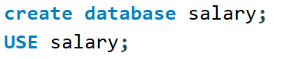
Database Design and SQL Integration
A MySQL database named 'salary' was created to store :

Slide 6
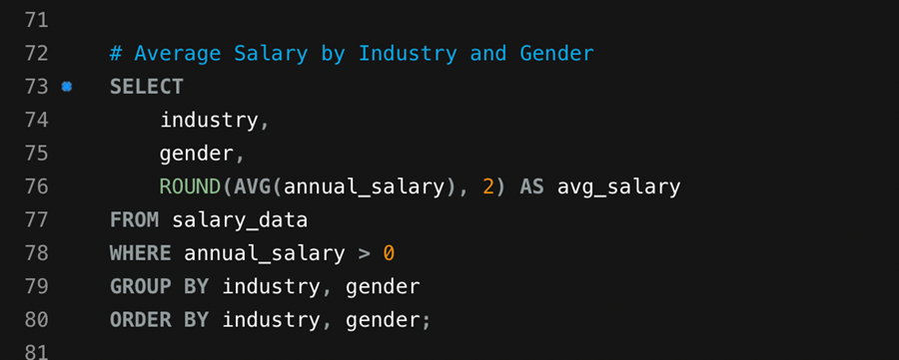
Data Analysis and SQL-Based Insights
Average Salary by Industry and Gender
This query revealed noticeable salary differences across industries and genders. Industries like Technology and Finance showed higher average salaries, with some gender pay gaps visible. The SQL script included all required table creation and loading commands.

Slide 7
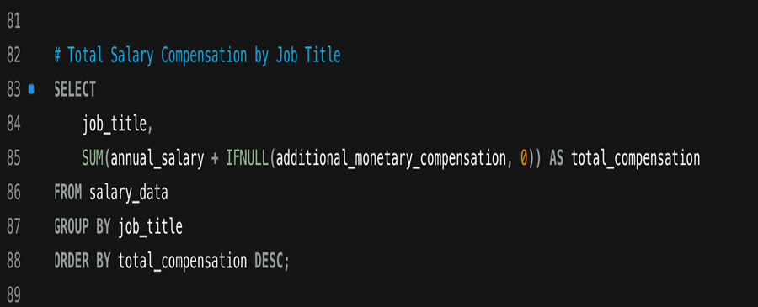
Total Salary Compensation by Job Title
The analysis showed that senior managerial roles and specialized technical positions commanded the highest total compensation

Slide 8
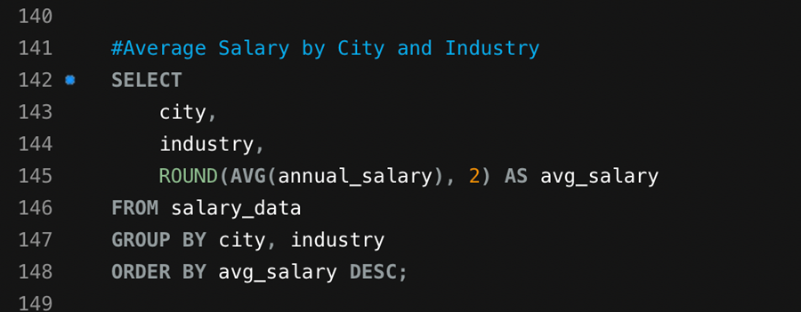
Average Salary by City and Industry
Cities like San Francisco, London, and Bangalore reported higher average salaries within the technology sector

Slide 9
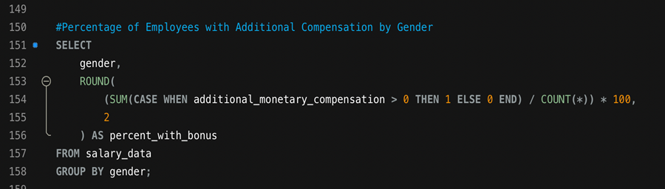
Percentage of Employees with Additional Compensation by Gender
A higher percentage of male employees received additional bonuses compared to female employees, indicating potential benefit disparities

Slide 10
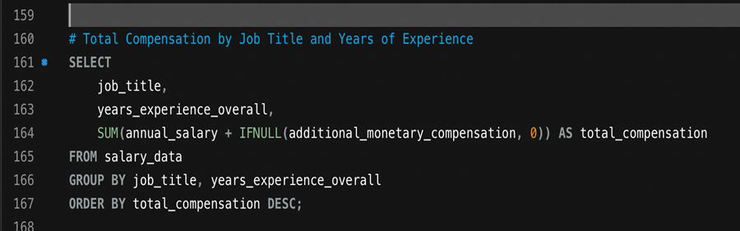
Total Compensation by Job Title and Experience
There was a strong positive relationship between years of experience and total compensation across all job roles

Slide 11
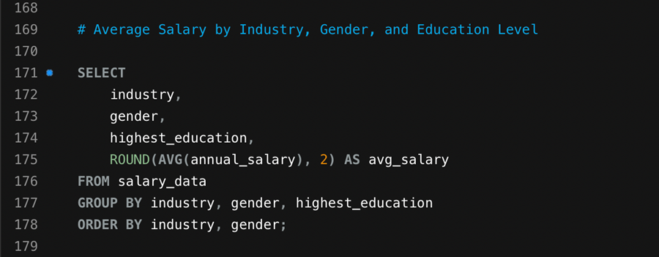
Average Salary by Industry, Gender, and Education Level
This combined query revealed that education amplified salary benefits across industries, particularly in technical and financial fields.

Slide 12
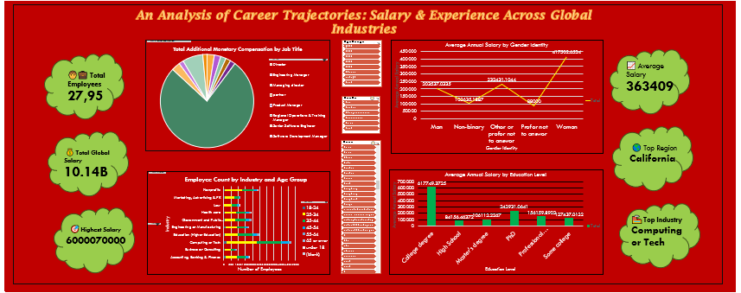
Excel Dashboard Creation
The SQL query results were exported from MySQL and imported into Excel. Separate sheets were created for each analysis result. Pivot tables and charts were developed to visualize patterns and trends. A final dashboard was created summarizing key findings such as salary distribution, gender representation, and top-paying industries.
.

Slide 13
Key Insights and Findings
Technology and Finance industries offered the highest salaries globally.
Salary growth correlates strongly with professional experience and education level.
Gender pay disparities exist across several industries, though narrowing in some regions.
• Cities like San Francisco and London remain salary hubs for technical roles.
• Senior management and specialized technical roles consistently yield the highest compensation.

Slide 14
Conclusion
This analysis provides a comprehensive understanding of how salaries vary globally across industries, education levels, and experience ranges. It highlights the importance of higher education, experience, and industry specialization in career progression. The final dashboard and SQL analyses serve as valuable tools for organizations and individuals to make informed career and compensation decisions.

Slide 15
Tools and Technologies Used
• Microsoft Excel – Data visualization and dashboard creation • MySQL Workbench – Database management and SQL querying • Python (optional) – Data cleaning and preprocessing • Microsoft Word – Report documentation

Slide 16
THANK YOU!!!

